Slide 1
Linear power converters
Advantages
Simplicity in Design
No electrical noise in the output
Fast dynamic response time
Low cost
Disadvantages
Both input and output are of the same range.
only one output
Low efficiency

Slide 2
RESONANT CONVERTERS

Slide 3
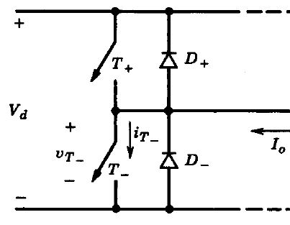
High Frequency Switch mode PWM Converters
Advantages
Higher efficiency
Devices operate at the maximum efficient points like cut off and saturation points
Multi-output is possible
Size and cost are much lower especially at high power levels.

Slide 4
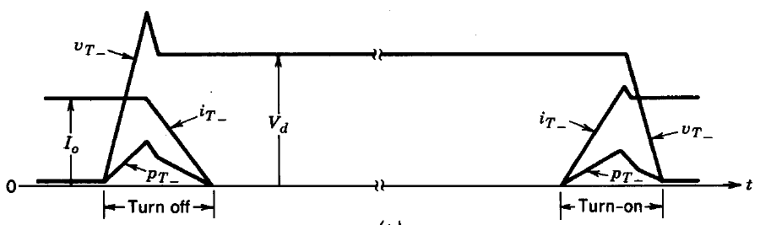
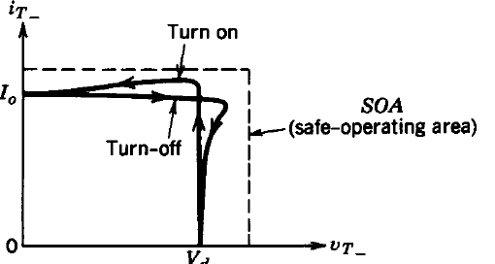
Limitations
Greater circuit complexity compared to linear converters
Controllable switches (operated in a switch mode) are required
to turn on and turn off the entire load current during each switching.
occurrence of large di/dt and dv/dt during switching.
Hence high electromagnetic interferences.
High stress levels on devices that
increases linearly with the switching frequency of the PWM.
Higher switching losses at high frequencies.

Slide 5
Dissipative snubbers circuits:
The switch stresses can be reduced by connecting simple dissipative circuits in series and parallel with the switches in the switch-mode converters.
These snubbers shift the switching power loss from the switch to the snubber circuit and therefore do not provide a reduction in the overall switching power loss.
Switching loci with snubbers Dissipative snubbers circuits

Slide 6
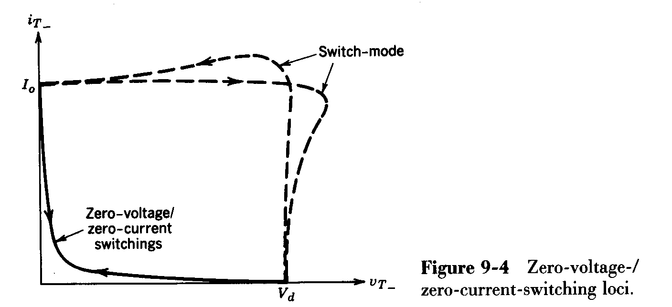
To minimize these problems, switches are made to change the states of turn on to turn off or vice versa when the voltage across it or current through it is zero at the switching instant.
These topologies require some form of LC resonance and hence, they are classified as resonant converters.
The switch voltage and current are shaped so as to get zero voltage and/or zero current during switching and they are known as soft switching converters.

Slide 7
Advantages of soft switching resonant converters
Reduced power loss at high switching frequency
Less size and hence high power density
High efficiency
Less stress on the devices

Slide 8
Classification of Resonant converters
Resonant converters
Load-resonant converters
Resonant-switch converters
Resonant-dc-link converters
High-frequency-link integral-half-cycle converters
Voltage-source series-resonant converters
Series Loaded Resonant converters
Parallel Loaded Resonant converters
Hybrid converters
Current-source parallel-resonant converters
Class E and subclass E resonant converters
ZCS converters
ZVS converters
ZVS-CV converters
Resonant-switch dc—dc converters

Slide 9
Resonant switch converters
Additional circuit elements are added to get zero voltage/zero current switching and are called resonant switch converters.
zero current switching (ZCS) topology
zero voltage switching (ZVS) topology
zero voltage switching, clamped voltage (ZVS--CV) topology

Slide 10
LC resonance is utilized to shape the switch voltage and current to provide zero-voltage and/or zero-current switching.
During one switching period, there are resonant as well as non-resonant operating intervals. Therefore, these converters are also known as quasi-resonant converters.

Slide 11
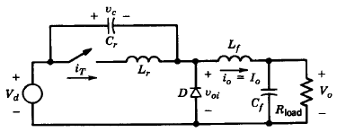
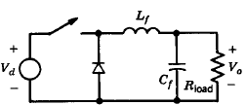
zero current switching (ZCS) Converters
The switch turn on and turn off occurs at zero current.
L_{r} and C_{r} are the are the resonant elements used to get zero current turn on and turn off conditions.

Slide 12
Initial Conditions
Let the switch is in the off state.
Diode is in the on state.
V_{c} = V_{d,} i_{T} = 0
At t = t₀ switch is turned on
Due to the presence of inductance, turn on occurs at zero current.
L_{r} and C_{r} are shorted through the switch
V_{oi} = V_{d} - V_{c}
= 0
Diode continues to conduct.
V_{Lr} = V_{c} = V_{d}

Slide 13
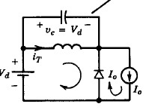
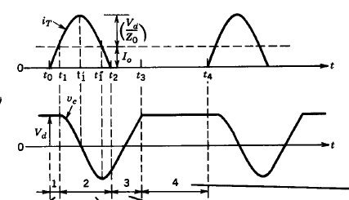
t₀ → t₁
v_{Lr} = V_{d}
i_{T} rises linearly.
i_{T} is less than i_{Lf}.
i_{D} =
D continues to conduct until i_{T} is equal to i_{Lf}.= I₀
V_{c} =
At t = t_{1,}
i_{T} is equal to i_{Lf}
D stops conducting.
L_{r} and C_{r} form a parallel resonant circuit.

Slide 14
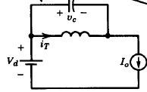
t₁ → t₁’
C_{r} discharges from V_{d} to zero through switch and L_{r}
i_{T} =
At t₁’ i_{T} and i_{c} are at their peak values.
V_{c} reaches zero
t₁’
t₁’

Slide 15
t₁’ → t₁’’
i_{c} decreases sinusoidaly to zero
At t₁’’
V_{c} reaches - V_{d}
t₁’
t₁’ ’
i_{c} = 0
i_{T} = I₀
t₁’
t₁’ ’

Slide 16
Capacitor discharges sinusoidaly
in the negative direction.
i_{T} =
i_{T} reduces to zero sinusoidaly.
Switch is turned
off naturally
t₁’
t₂
t₁’ ’
t₁’ ’
turn off occurs at zero current.

Slide 17
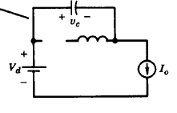
t₂ → t₃
Capacitor discharges through the load circuit
i_{c} =
V_{c} rises linearly to V_{d}
At t = t₃
V_{c} = V_{d}
V_{diode}= 0
Diode conducts
Off period of the converter begins
t₂
t₁’ ’
t₁’ ’

Slide 18
t₃ → t₄
Switch is off.
Load current freewheels through
diode
V_{c} = V_{d}
i_{T} = 0
At t₄ gate pulse is given to switch
to begin next cycle

Slide 19
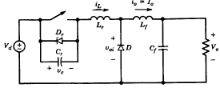
zero voltage switching (ZVS) Converters
The switch turn on and turn off occurs at zero voltage.

Slide 20
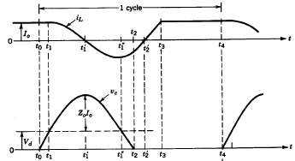
Initial condition
the switch is in the on state. D is off
V_{c} =
i_{L} =
V_{0i} =
At t = t₀ switch is
turned off
Due to the presence of
capacitance,
turn off occurs at zero voltage.
t₀ → t₁
i_{L} which is constant load current flows through the capacitor
V_{c} rises linearly from zero to V_{d}
At t = t₁, V_{c} = V_{d}
V_{0i} =
D starts conducting
t₁
t₁

Slide 21
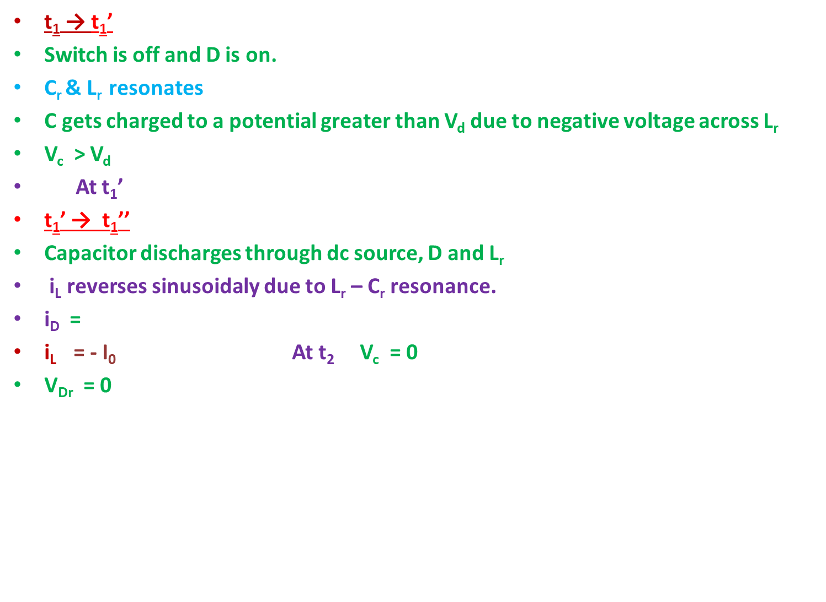

t₁ → t₁’
Switch is off and D is on.
C_{r} & L_{r} resonates
C gets charged to a potential greater than V_{d} due to negative voltage across L_{r}
V_{c} > V_{d}
At t₁’
t₁’ → t₁’’
Capacitor discharges through dc source, D and L_{r}
i_{L} reverses sinusoidaly due to L_{r} – C_{r} resonance.
i_{D} =
i_{L} = - I₀ At t₂ V_{c} = 0
V_{Dr} = 0
i_{L} is zero
V_{c} is maximum =
V_{d} + V_{Lr}
$I_{0}$-$I_{L}$
At t₁’’ V_{c} = V_{d}
t₁

Slide 22
D_{r} starts conducting.
V_{c} continues to be at zero
t₂ → t₂’
D & D_{r} conduct.
V_{cr} = 0
i_{L} rises linearly to zero through D_{r}.
At t₂’ , i_{L} = i_{Dr} = 0,
Gating signals are applied to the switch during this interval
V_{cr} continuous to be at zero potential and the turn on occurs at zero voltage.
Peak voltage across the switch is 2V_{d}
V_{Lr} = V_{d}
V_{Lr} = V_{d}
Switch is reverse biased while D_{r} is conducting
D_{r} becomes off and switch goes to the on state

Slide 23
Switch becomes on at
t₂’ when i_{L} = i_{Dr} = 0 and
D_{r} is off.
V_{c} remain at zero.
Turn on occurs at zero voltage condition
t₂’ → t₃
i_{D} = zero, D becomes off
i_{L} rises linearly to I₀
D is still conducting.
V_{Lr} = V_{d}

Slide 24
t₃ → t₄
i_{L} = I_{T} = I₀
V_{c} = 0
V₀ = V_{d}
At t₄ switch is turned off again at zero voltage

Slide 25
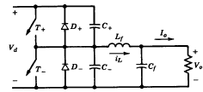
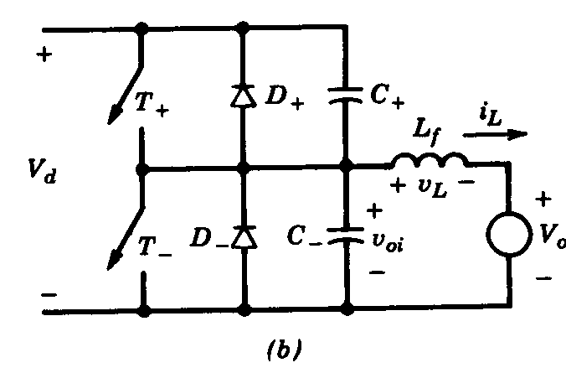
Zero voltage switching clamped voltage (ZVS-CV) Topology
Switches turn on and turn off at zero voltage.
Peak voltage across the switch is clamped to the input dc voltage
C_{f} is considered as very large and hence load is replaced by the voltage source V₀

Slide 26
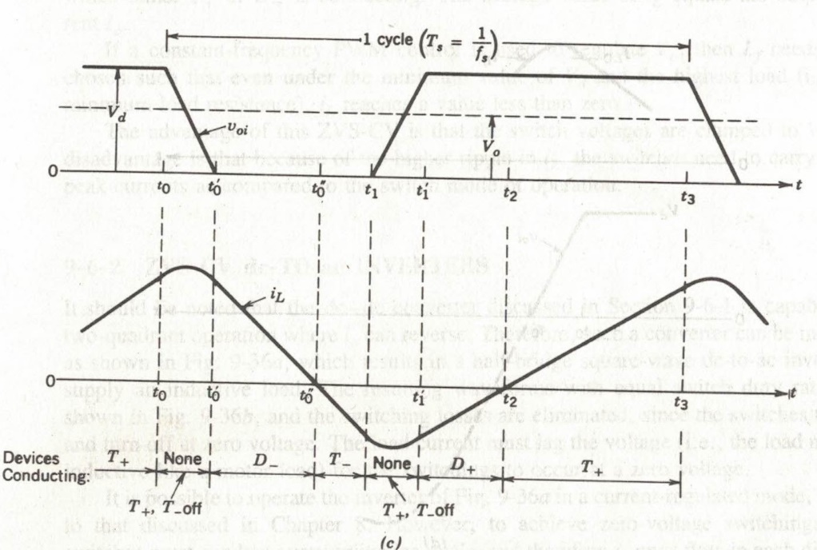
Initial condition
T₊ is on. T₋ is off.
V_{L} = (constant)
i_{L} rises linearly
= V_{C+} voltage across C₊ is zero
V_{C-} =
V_{T+} = 0
At t = t₀, T₊ is turned off at zero voltage due to V_{C+}
v_{oi}
i_{L}

Slide 27
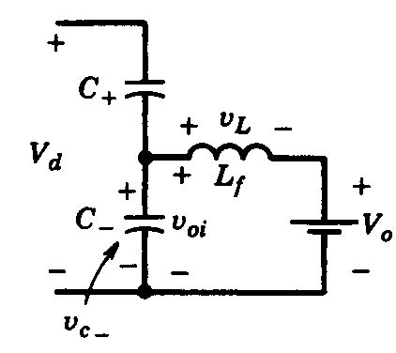
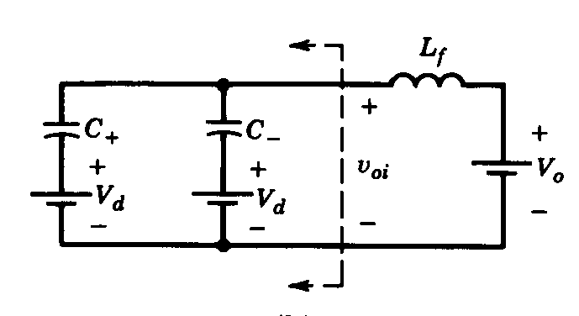
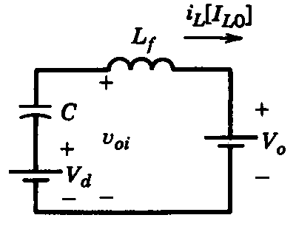

t₀ → t₀’
C₊ = C₋ = ½ C are selected as of small values. The resonant frequency f₀ = 1/(2π$\sqrt{LfC}$) is very large compared to switching frequency.
L_{f}/C is very large and variation in I_{L} is very small.
i_{L} = I₀ = i_{C+} + i_{C-}
T+ , T-, D+ and D- are in the off state
C- has an initial voltage of V_{d}
equivalent circuit
Thevenin equivalent circuit
C = C₊ + C₋

Slide 28
V_{C+} changes linearly from 0 to V_{d}
V_{C-} = V_{oi} = decreases linearly from V_{d} to zero
C₊ = C₋
v_{oi}
i_{L}

Slide 29
At t = t₀’,
D- starts conducting
i_{L} decreases linearly to zero at t₀’’
T- is gated while D- is conducting.
T- starts conducting when D- becomes off due to zero i_{L} at t₀’’
t₀’’ → t₁
i_{L} flows through T₋
v_{L} = - v₀
v_{c-} = 0 = v_{oi} = v_{D-}
v_{L} = - v₀
Maximum voltage that comes across T+ is V_{d}
At t₁ T₋ is turned off.
v_{oi}
i_{L}

Slide 30
t₁ → t₁’
T₊ and T₋ are off.
Negative i_{L} flows through C₋
C₊ discharges from V_{d} to 0
C₋ gets charged from 0 to V_{d}.
t₁’ → t₂
When V_{C+} is zero, D₊ conducts negative i_{L}.
V_{L} =
V_{C-} = V_{oi} = V_{d}
T+ is gated while D+ is conducting.
T+ starts conducting when D+ becomes off when i_{L} is reduced to zero at t₂
v_{oi}
i_{L}

Slide 31
t₂ → t₃
T+ becomes on at
zero voltage condition.
V_{L} =
i_{L} rises positively through T₊ and load.
v_{oi}
i_{L}

Slide 32
LOAD-RESONANT CONVERTERS
Consist of an LC resonant tank circuit
A series LC or a parallel LC circuit can be used to produce oscillating voltage and current.
Converter switches can switched at zero voltage and/or zero current.
These converters can be sub-classified as :
A. Voltage-source series-resonant converters
(a) Series-loaded resonant (SLR) converters
(b) Parallel-loaded resonant (PLR) converters
(c) Hybrid-resonant converters
B. Current-source parallel-resonant converters
C. Class E and subclass E resonant converters

Slide 33
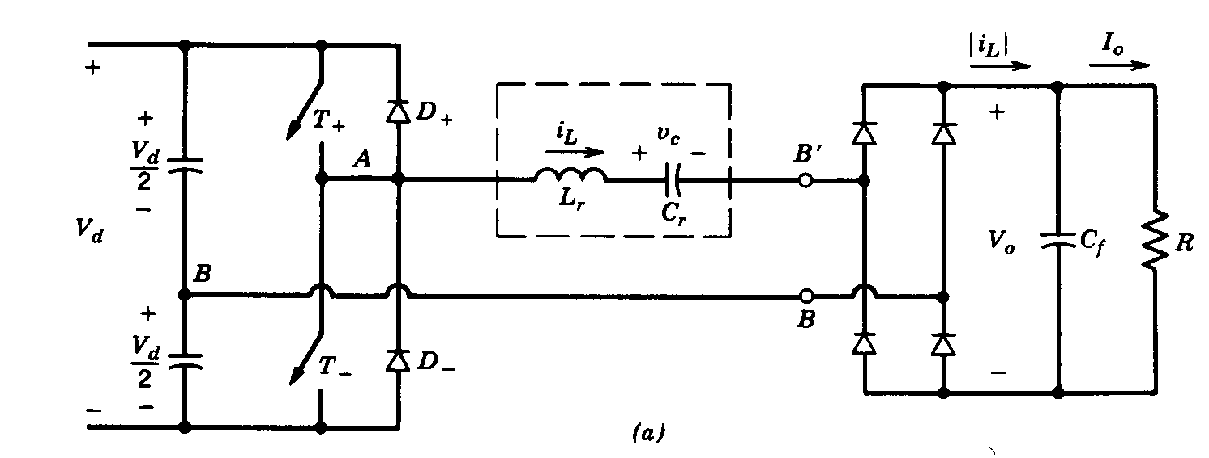
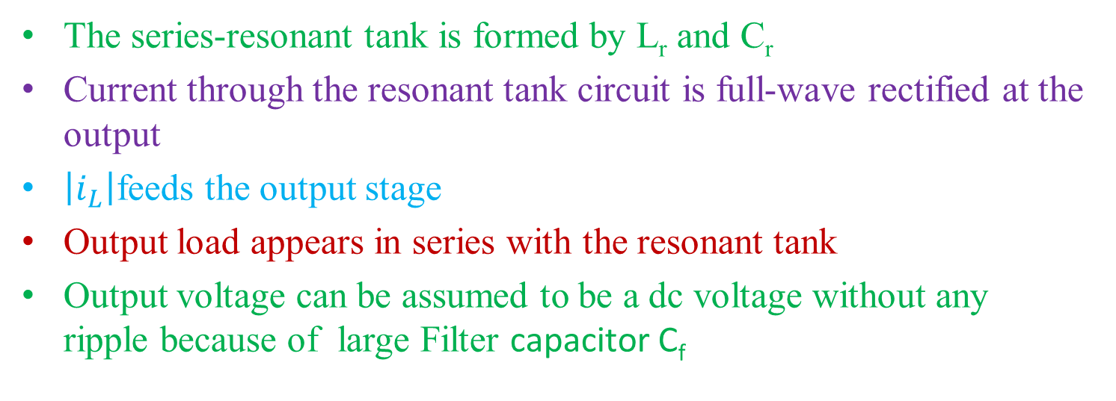
SERIES-LOADED RESONANT (SLR) dc-dc CONVERTERS
Half-Bridge SLR converter
The series-resonant tank is formed by L_{r} and C_{r}
Current through the resonant tank circuit is full-wave rectified at the output
$\left|i_{L}\right|$feeds the output stage
Output load appears in series with the resonant tank
Output voltage can be assumed to be a dc voltage without any ripple because of large Filter capacitor C_{f}

Slide 34
Resistive power loss in the resonant circuit is assumed to be negligible
The output voltage V_{o} is reflected across the rectifier input as V_{B’B}
V_{B’B} = V_{o} if i_{L} is positive
= - V_{o} if i_{L} is negative

Slide 35

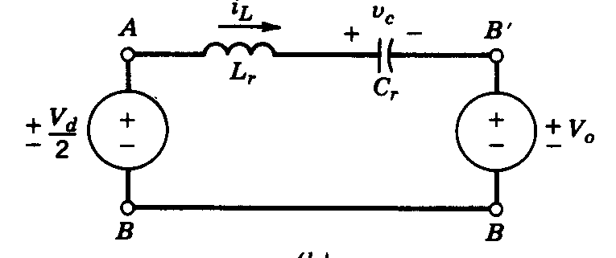
For i_{L} > 0
If T+ conducts
If D- conducts
When i_{L} is positive, it flows through T+ or through the diode D-

Slide 36
For i_{L} < 0
If T- conducts
If D+ conducts
When i_{L} is negative, it flows through T- or through the diode D+

Slide 37
The average output voltage V₀ cannot exceed V_{d}/2

Slide 38
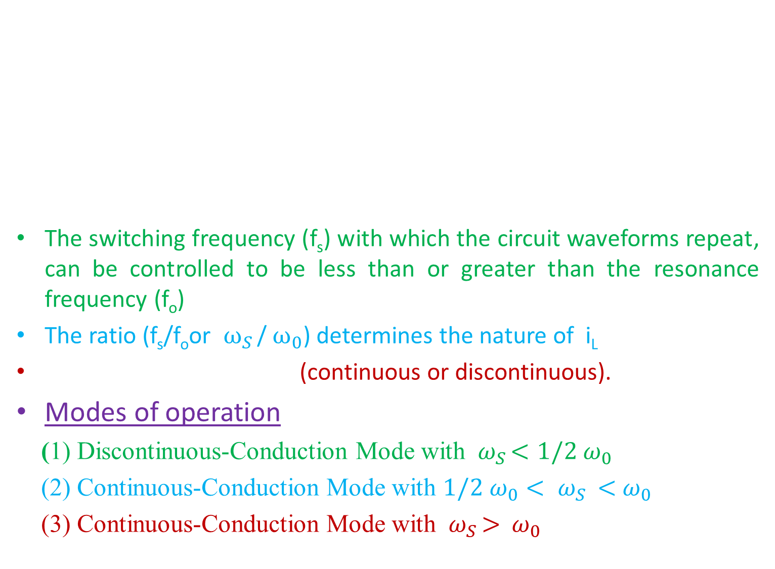
The switching frequency (f_{s}) with which the circuit waveforms repeat, can be controlled to be less than or greater than the resonance frequency (f_{o})
The ratio (f_{s}/f_{o}or ${ ω}_{S }$/${ ω}_{0}$) determines the nature of i_{L}
(continuous or discontinuous).
Modes of operation
(1) Discontinuous-Conduction Mode with ${ ω}_{S }<{1/2 ω}_{0}$
(2) Continuous-Conduction Mode with ${{1/2 ω}_{0}< ω}_{S }<{ ω}_{0}$
(3) Continuous-Conduction Mode with ${ ω}_{S }>{ ω}_{0}$

Slide 39


Discontinuous-Conduction Mode with ${ ω}_{S }<{1/2 ω}_{0}$
T_{s}/2 > T₀
Initial conditions
V_{c} = - 2v₀
i_{L} = 0
At ω₀t₀, T₊ is turned on.
ω₀t₀ → ω₀t₁
i_{L} rises from zero and
v_{c} builds up from -2V₀.
At ω₀t₀, V_{L} =

Slide 40
At ω₀t₁ i_{L} becomes zero and T+ becomes off
V_{L} (ω₀t₁) =
V_{c} (ω₀t₁) =

Slide 41
i_{L} reverses and flows through D+
V_{L} (ω₀t₁) =
At ω₀t₂, i_{L} becomes zero
and D₊ becomes off.
V_{L} (ω₀t₂) =
V_{c} (ω₀t₂) =

Slide 42
ω₀t₂ → ω₀t₃
All devices are off.
i_{L} = 0
V_{c} = 2V₀

Slide 43
At T_{s}/2 = ω₀t₃,
T- is turned on.
i_{L} is negative.
At (ω₀t₃ + π) i_{L} becomes
zero and T- becomes off
i_{L} reverses in the positive
direction through D₋

Slide 44

(1) Discontinuous-Conduction Mode with ${ ω}_{S }<{1/2 ω}_{0}$

Slide 45

(2) Continuous-Conduction Mode with ${{1/2 ω}_{0}< ω}_{S }<{ ω}_{0}$

Slide 46

(3) Continuous-Conduction Mode with ${ ω}_{S }>{ ω}_{0}$

Slide 47
Control of SLR dc—dc converter
Steady-state characteristics of an SLR

Slide 48
PARALLEL-LOADED RESONANT (PLR) dc-dc CONVERTERS
The series-resonant tank is formed by L_{r} and C_{r}
Output load appears in parallel with the resonant tank
Half-Bridge PLR converter

Slide 49
The voltage across the resonant-tank capacitor Cr is rectified, filtered, and then supplied to the load
Current through the output filter inductor is assumed to be a ripple-free dc current Io during a switching frequency time period (at high switching frequency and a sufficiently large value of the filter inductor)
The voltage across the resonant tank depends on the devices conducting as follows:
T+ or D+ conducting: V_{AB} = +1/2 V_{D}
T- or D- conducting: V_{AB} = -1/2 V_{D}
Equivalent circuit

Slide 50
MODES OF OPERATION (1) Discontinuous-Conduction Mode

Slide 51

(2) Continuous-Conduction Mode with $ω_{S }<{ ω}_{0}$

Slide 52

(3) Continuous-Conduction Mode with ${ ω}_{S }>{ ω}_{0}$

Slide 53
(c) Hybrid RESONANT dc-dc CONVERTERS
This topology consists of a series-resonant circuit
load connected in parallel with only part of the capacitance, for example, one-third of the capacitance, and the other two-thirds of the capacitance appears in series.
Have the advantageous of both the SLR and the PI-R converters
SLR convener offers an inherent current limiting under short circuit conditions
PLR converter acts as a voltage source and thus regulating its voltage at no load with a high-Q resonant tank is not a problem.

Slide 54
1(B) CURRENT-SOURCE PARALLEL-RESONANT DC-AC INVERTERS FOR INDUCTION HEATING
circuit phasor diagram
a square-wave current source is applied to a parallel-resonant load
The induction coil and the load (RL combination) are modelled by means of a parallel combination of equivalent R_{load} and L_{r}, rather than a series RL.
The capacitor C_{r} is added to resonate with L_{r} in parallel.
It is assumed that the harmonic impedance of the parallel-resonant load at the harmonic frequencies of the input current source is negligibly small, thus resulting in an essentially sinusoidal voltage v_{o}.

Slide 55
Current-source parallel-resonant inverter for induction heating:
A small inductance Lc ( in series with resonant load) is used to avoid a large di/dt (during current commutation) through the inverter Thyristors
The inverter output current io therefore deviates from its idealized square-wave shape and becomes trapezoidal
Power output of this inverter is controlled by controlling its switching frequency or DC current Id
After the thyristor stops conducting, a reverse voltage appears across it for a time interval equal to γ/ω_{s} and thyristor has to block a forward-polarity voltage.
Therefore, γ/ω_{s} should be sufficiently than the turn-off time tq of the
thyristor
(a) circuit (b) waveforms

Slide 56
1(C) CLASS E CONVERTERS
Load is supplied through the sharply tuned series-resonant circuit
which results in a sinusoidal output current.
The input to the converter is fed through a sufficiently large inductor
Therefore, in steady state, the input to the converter is a dc current source Id (where the current magnitude depends on the power output)
Advantages
Elimination of switching losses
Reduction in EMI
Produces a sinusoidal output current with a single-switch
Disadvantages:
high peak voltage and current associated with the switch
Large voltages and currents through the resonant LC elements
It is possible to obtain a dc—dc voltage conversion by rectifying the output current.
Used for high-frequency electronic lamp ballasts.
Since the output load may vary over a large range, an impedance matching network is required between the output of the class E converter and the output rectification stage to ensure a lossless switching operation of the class E converter

Slide 57
When the switch is on: Id + io flows through the switch
When the switch is turned off:
Because of the capacitor C_{l} , the voltage across the switch builds up slowly, thus allowing a zero-voltage turn-off of the switch.
Voltage across capacitor C_{l} builds up, reaches its peak, and eventually comes back to zero, at which instant the switch is turned back on.
A class E converter operates at a switching fs, which is slightly higher than the resonant frequency fo
During the interval when the switch is off, the input supplies to the circuit since V_{T} is positive
The average value of V_{T} equals V_{d}.
If io is assumed to be purely sinusoidal,
the average voltage across the load
resistance R is zero.
The average voltage across Lr is also zero in steady state.
Therefore, Cr blocks the dc voltage V_{d} in addition to providing a resonant circuit.

Slide 58
Class E converter: Modes
Optimum mode
Switch voltage returns to zero with a zero slope (i_{C1} = 0)
Load resistance R be equal to an optimum value Ropt.
No need for a diode in antiparallel with the switch.
The switch duty ratio D = 0.5 results in a maximum power capability (maximum switch utilization ratio)
Non-Optimum mode
Switch voltage reaches zero with a negative slope
dV_{T}/dt < 0 and i_{C1}=C_{l} (dVr/dt) < 0
R < Ropt
A diode is connected in antiparallel with the to allow this current to flow while keeping the switch voltage at zero (at one diode drop).
Switch is turned on as soon as the diode starts to conduct.

Slide 59
Class E converter: Optimum mode

Slide 60
Class E converter: Non-optimum mode

Slide 61
Advantages of resonant converters:
Solution to the problem faced in hard-switched (PWM-type) converters, as they allow zero-current or zero-voltage switching.
Circuit operation is possible at higher frequency, reducing the size of reactive components.
Owing to smooth waveforms of voltage and current, noise and interference effects are reduced.
Stresses on the switching devices also reduce because of zero-voltage/zero-current switching.
HF transformer non-idealities can be incorporated as a part of circuit itself.
Operation even under output short-circuit condition is possible.

